Slide 1

CSCI 680 Affective Computing
Ashley Y. Gao
Department of Computer Science
William & Mary
Disclaimer: Some images used in this slide are AI-generated.

Slide 2


Slide 3
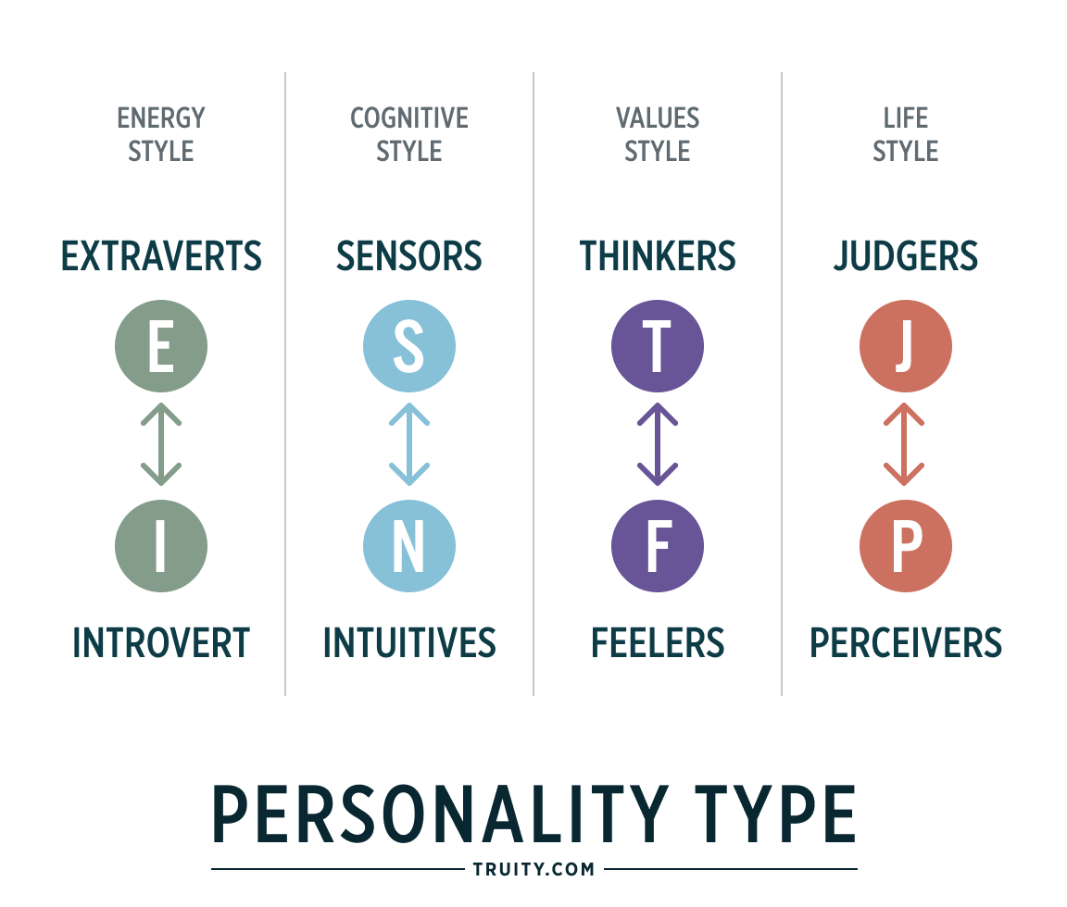
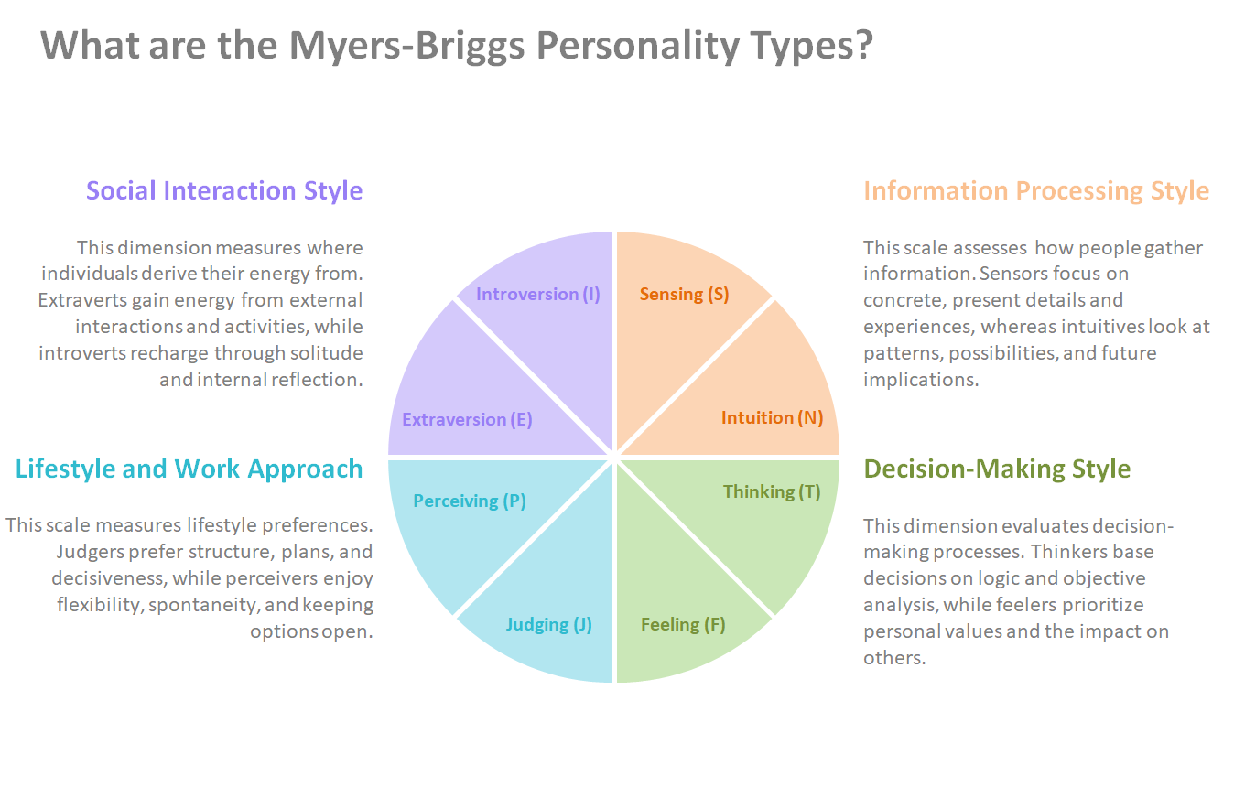
Thinking v. Feeling as Opposites
More info here.

Slide 4
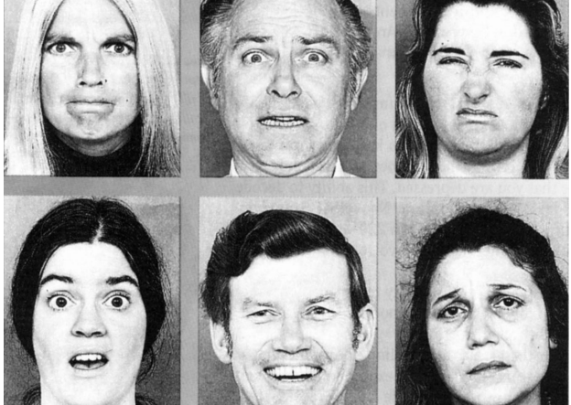
Facial “Expressions of Emotion” and the Ekman Program
The "Ekman Program" refers to the psychological training and research developed by pioneering emotion psychologist Dr. Paul Ekman.
It encompasses the Facial Action Coding System (FACS), micro-expression recognition training (METT), and Cultivating Emotional Balance (CEB) to improve emotional intelligence, detect deception, and regulate moods.

Slide 5

Affective Computing
R. Picard 1997 book “Affective Computing”
This book proposes that we give computers the ability to recognize, express and in some cases “have” emotions. Is this not absurd?
Now:
IEEE Transactions on Affective Computing
International Conference on Affective Computing and Intelligent Interaction (ACII) → https://acii-conf.net/
Increasing awareness that emotions play a significant role in human intelligence
Still don’t have “emotional machines” - why not?

Slide 6
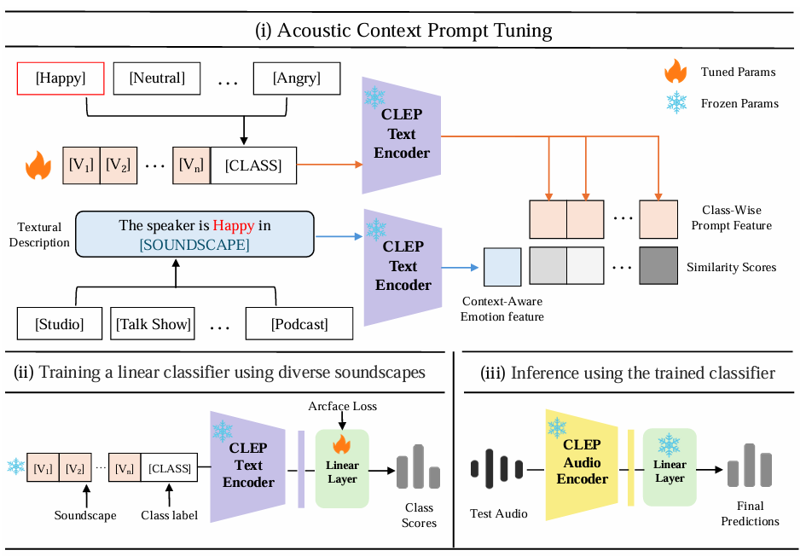
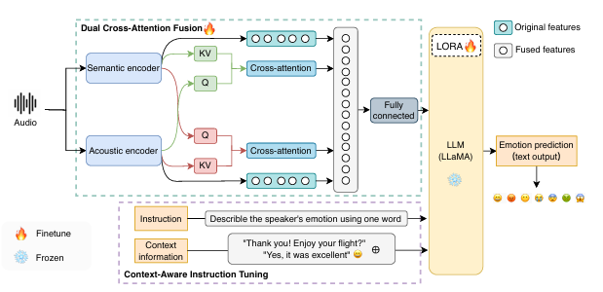
What Does It Mean for a Computer to “Recognize” Affect?
Sample Topic: Emotion Recognition/Classification
Challenges: distribution shifts among different speakers with different accents, from different cultural backgrounds, etc.
[1] Du, H., Lu, S., Zhou, G., & Gao, Y. (2025). EAA: Emotion-Aware Audio Large Language Models with Dual Cross-Attention and Context-Aware Instruction Tuning. In Proc. Interspeech 2025 (pp. 5433-5437).
[2] Shi, J., Zhang, Y., & Gao, Y. (2025). Clep-dg: Contrastive learning for speech emotion domain generalization via soft prompt tuning. arXiv preprint arXiv:2507.04048.

Slide 7
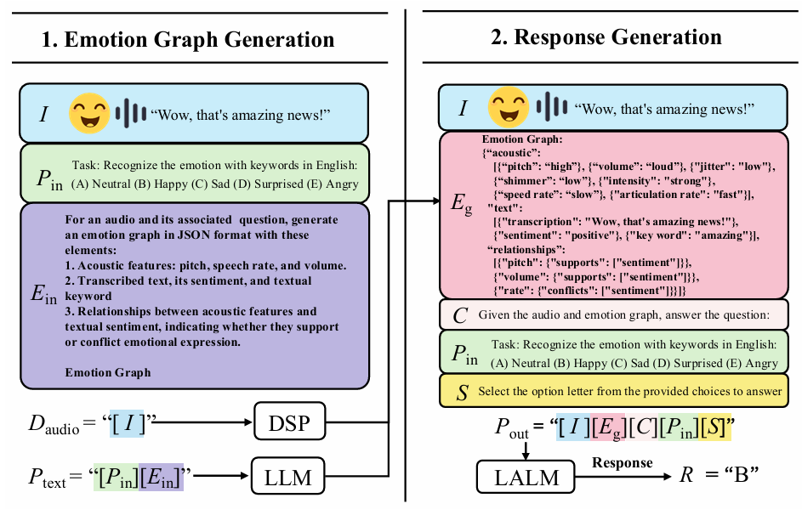
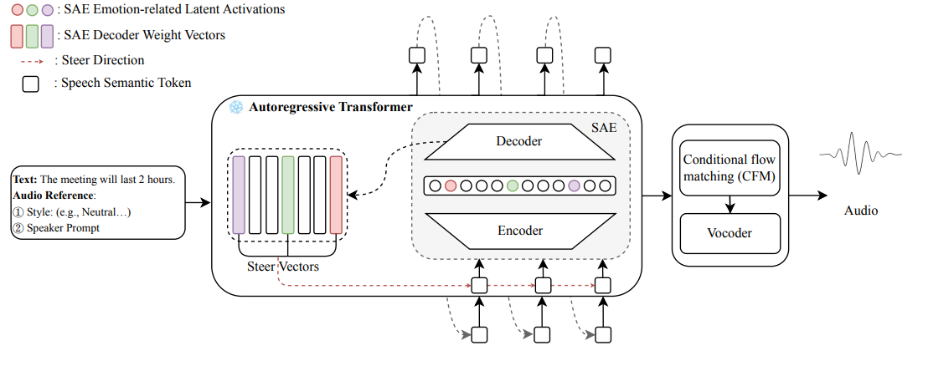
What Does It Mean for a Computer to “Express” Affect?
Sample Topic: Emotion Text-To-Speech (TTS)
Also seen in Generative AI in Computer Vision and Natural Language Processing
[1] Shi, J., Du, H., Hong, Y. A., & Gao, Y. (2026, May). Plug-and-Play Emotion Graphs for Compositional Prompting in Zero-Shot Speech Emotion Recognition. In ICASSP 2026-2026 IEEE International Conference on Acoustics, Speech and Signal Processing (ICASSP) (pp. 17177-17181). IEEE.
[2] Sparse Autoencoders for Interpretable Emotion Control in Text-to-Speech. - Du, H., Shi, J., Lu, S., Zhou, G., Gao, A. — Proceedings of the International Conference on Machine Learning (ICML)

Slide 8
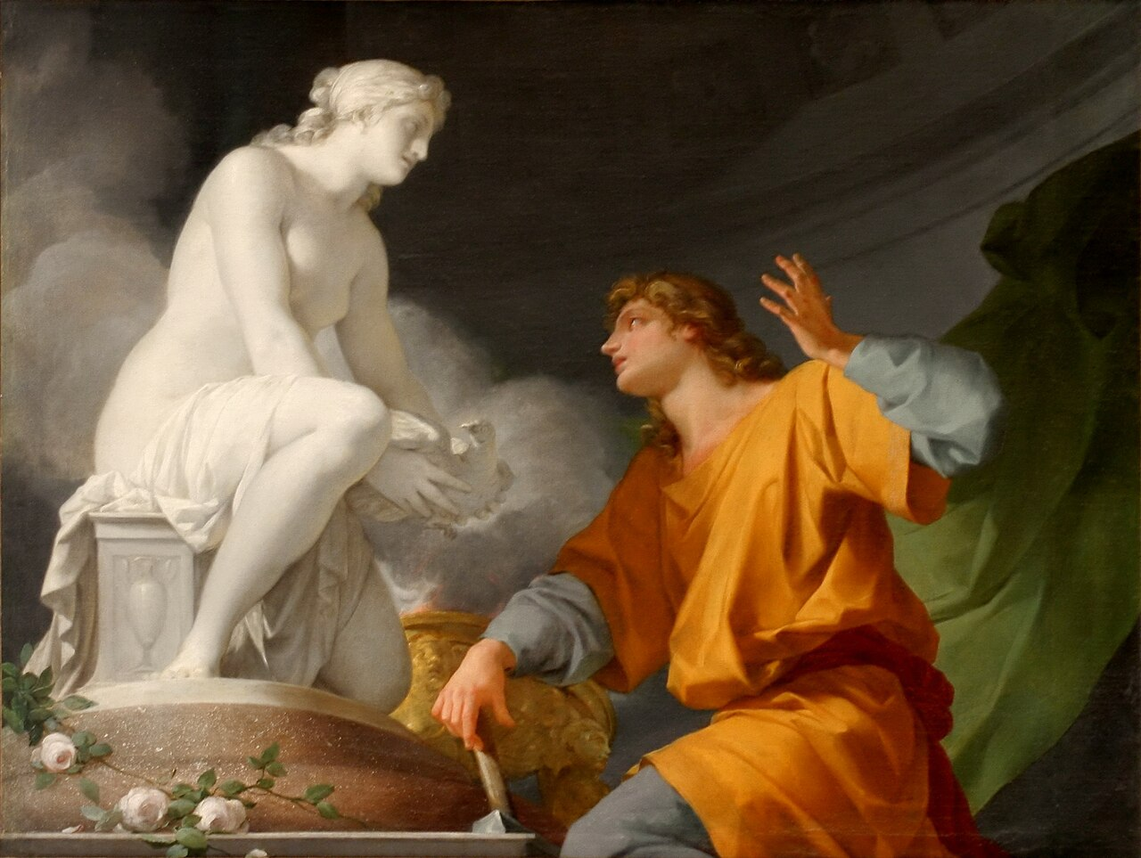
What Does It Mean for a Computer to “Have” Emotion?
See Pygmalion by Jean-Baptiste Regnault (1786).

Slide 9
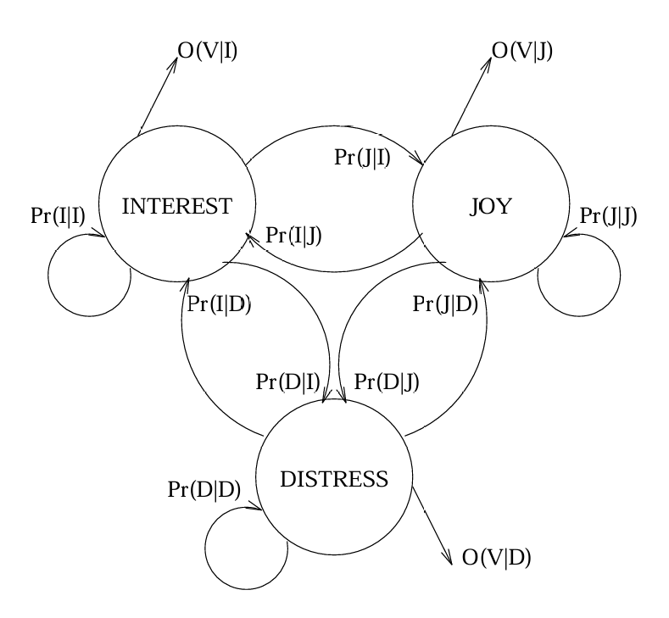
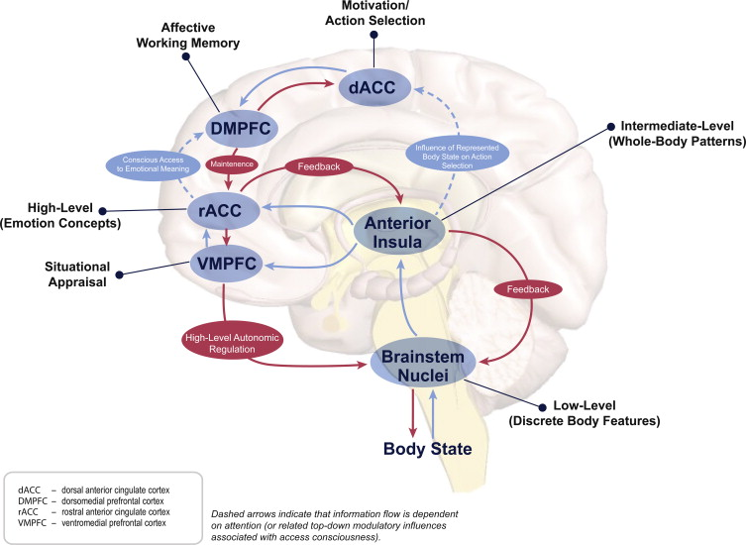
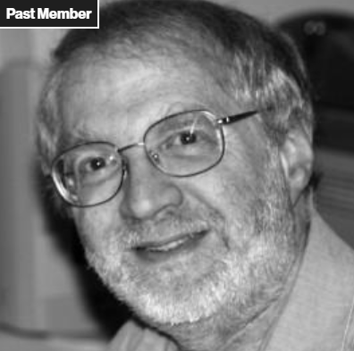
Emotion Is Not a Bug in Intelligence
Barry Kort: Learning is the quintessential emotional experience [5].
Notes:
emotions act as the brain's biological tagging system

Slide 10
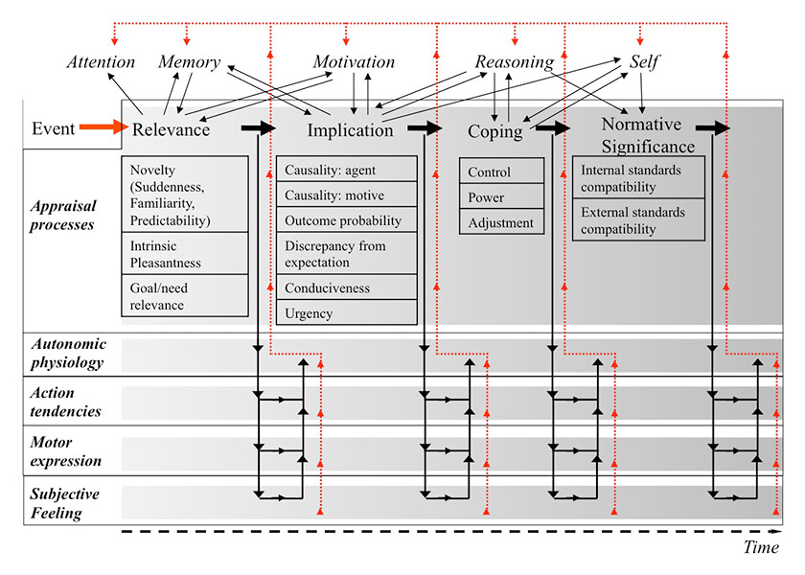
Emotion, Decision-Making, Learning, and Attention
Comprehensive illustration of the Component Process Model.
The model assumes that the appraisal process is organized in a sequence of four appraisal objectives.
Each appraisal outcome leads to changes in the other emotion components (physiology, action tendency, motor expression, and subjective feeling, as illustrated by the descending arrows).
The ongoing appraisal process furthermore interacts with other cognitive functions.
Notes:
Comprehensive illustration of the Component Process Model. The model assumes that the appraisal process is organised in a sequence of four appraisal objectives. Each appraisal outcome leads to changes in the other emotion components (physiology, action tendency, motor expression, and subjective feeling, as illustrated by the descending arrows). The ongoing appraisal process furthermore interacts with other cognitive functions. For example, minimal attention needs to be given for appraisal to start, but a relevance outcome will immediately deploy further attention to the stimulus. The model thus allows a detailed consideration of the effects of emotional processes on attention, memory, and other cognitive processes (as illustrated by the arrows in the upper part of the figure). Finally, changes in the other emotion components may also influence cognitive functions (as illustrated by the red ascending arrows), for example by increased memory consolidation via increases in physiological arousal, which may in turn influence the processing of appraisal criteria.

Slide 11
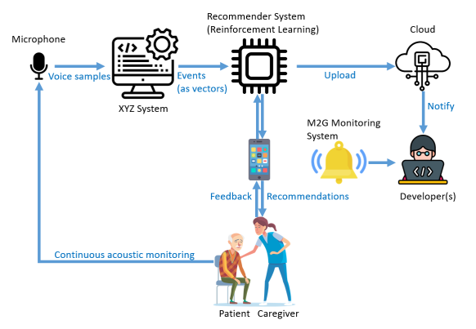
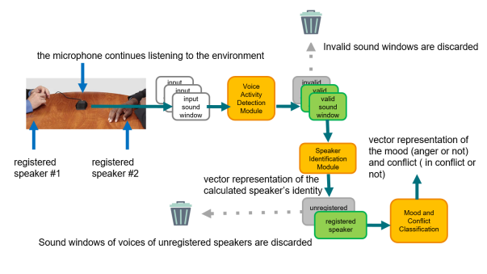
The Affective Loop: Sense, Infer, Respond, Adapt

Slide 12

Affective Computing Is Not Mind Reading

Slide 13
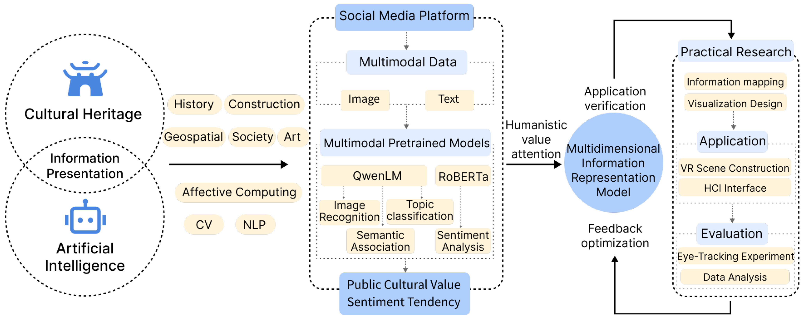
Where the Field Lives: AI, HCI, Psychology, Neuroscience

Slide 14
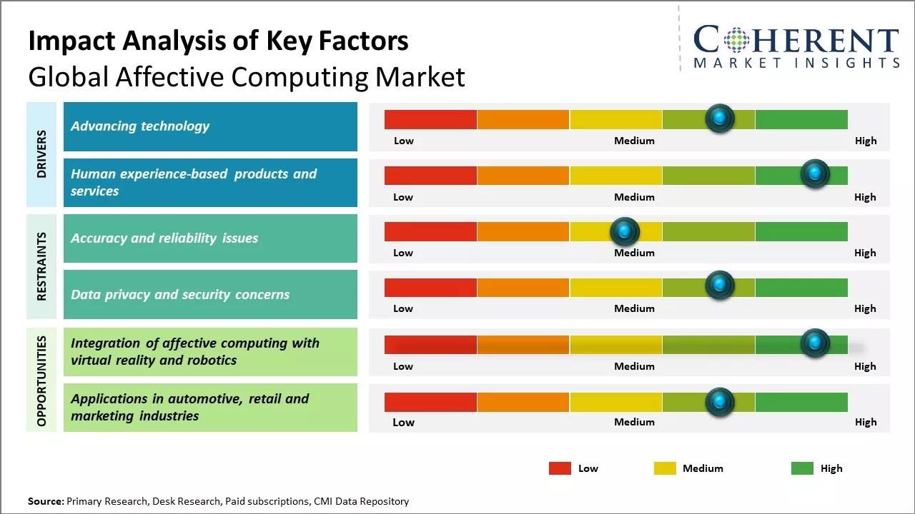
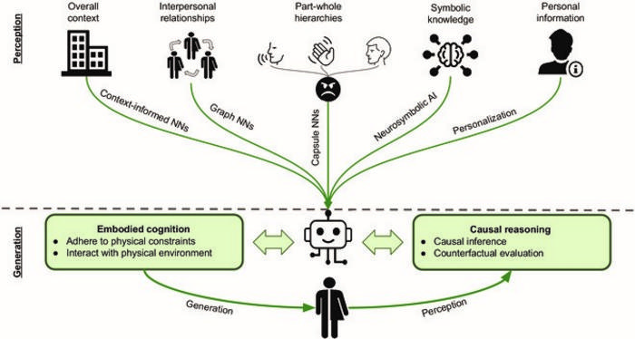
Applications: Health, Education, Entertainment, Social Interaction

Slide 15
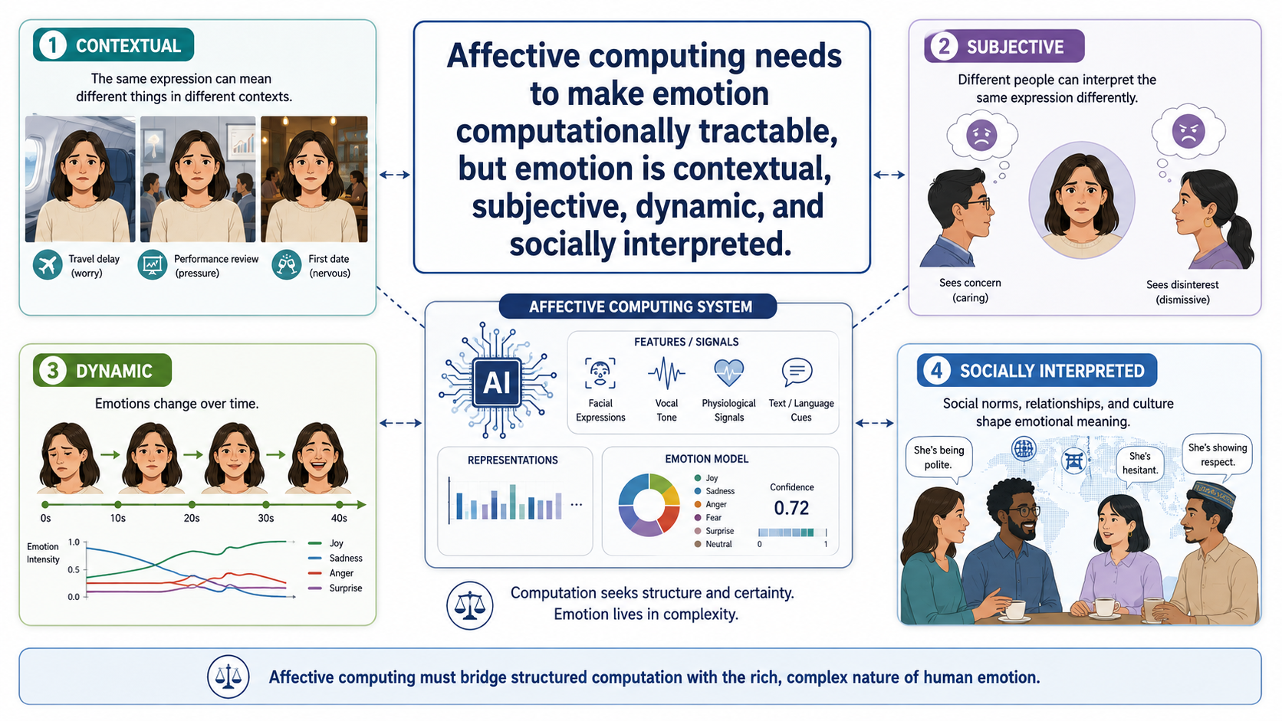

Slide 16
